Slide 1
By Michael Cannoot

Slide 2
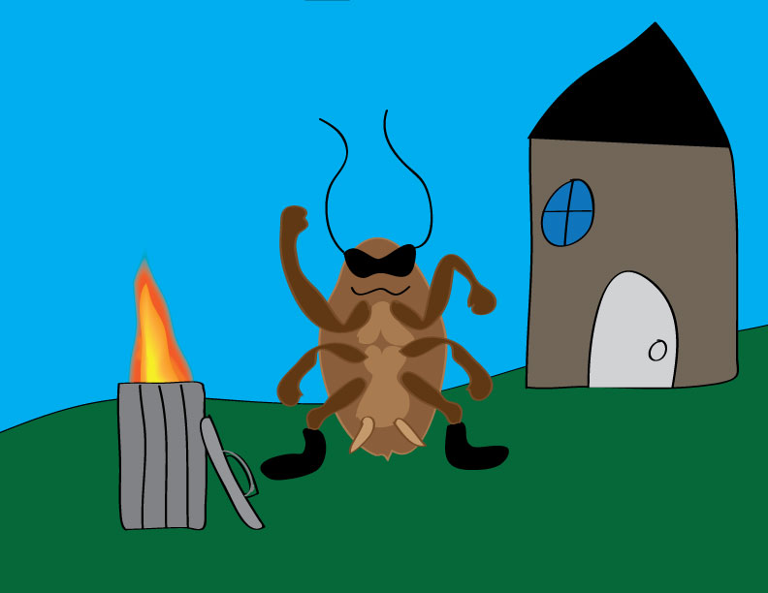
The Litterbug is wreaking havoc in the neighborhood! Help Captain General Trashman take out the trash!
Continue →

Slide 3
Answer The Litterbug’s trashy questions to defeat him! Who framed Rodger Rabbit in the movie “Who Framed Rodger Rabbit?”
Judge Doom
B. Jessica Rabbit
C. Bugs Bunny
D. Nobody

Slide 4
Answer The Litterbug’s trashy questions to defeat him! True or False: The Brontosaurus is a dinosaur.
A. True
B. False
C. Potato

Slide 5
Answer The Litterbug’s trashy questions to defeat him! Who invented the toilet?
A. John Crapper
B. John Harrington
C. Poopahontas
D. Prof. Bigg Schittz

Slide 6
G’ME OV’R
It laid eggs!!!
←Go back

Slide 7
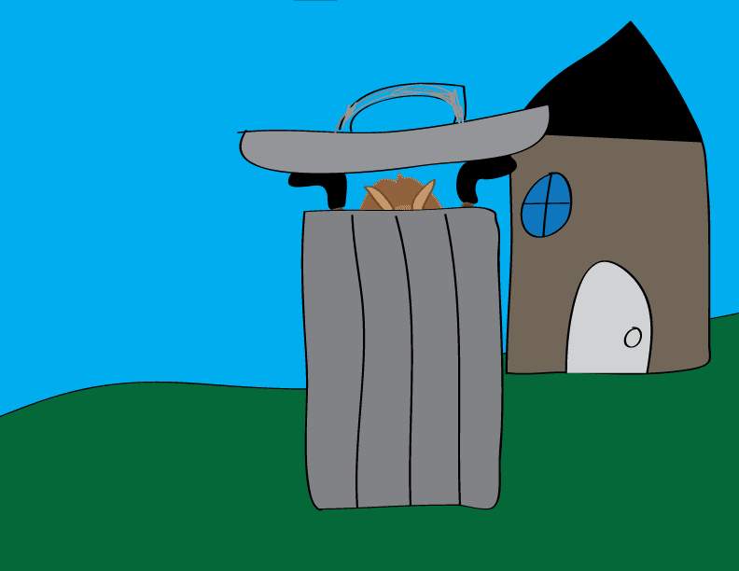
The Litterbug is trashed!
Click to claim prize!

